Slide 1


Millis Fire REscue
FY 2021 Budget Presentation

Slide 2
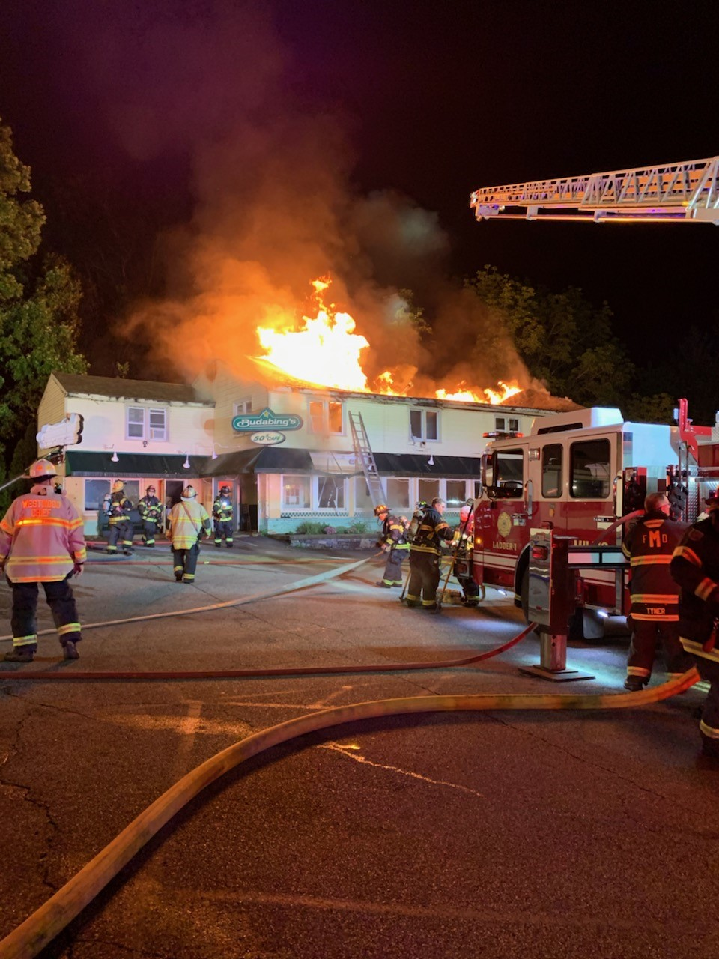
Department Function
The purpose of the Millis Fire/Rescue Department is to respond to all emergency and non-emergency calls for service from the residents of Millis and neighboring communities.
Calls for service:
Fires Medical Emergencies
Motor Vehicle Accidents Hazardous Materials
Weather Related Emergencies
Carbon Monoxide Emergencies Brush Fires
Ice/Water Rescues Gas Emergencies
Missing Persons Floods
Mutual Aid Fire/Medicals Technical Rescues
Inspections Building Plan Review
Code Compliance Public Education Permitting

Slide 3
Staffing
1 Fulltime Fire Chief 1 On Call Deputy Chief 4 Fulltime Lieutenants
12 Fulltime Firefighter/EMT’s 14 On Call Firefighter/EMT’s
Fire Chief: Monday-Friday 8am- 4pm Responds to calls as needed 24hrs/day, 365 days/yr.
On Call Deputy Chief: Responds to emergencies as needed, coordinates trainings
Full Time Members: Work a 4-group system, groups consist of 1 Lieutenant and 2 FF/EMT’s
Groups work a 24hr shift on/ 24hrs off/24 hrs. on/96hrs off.
On Call Members: Are assigned to a Group that follows the fulltime shift schedule and are responsible to cover from 6pm-6am. Additionally they must attend department trainings and meetings. Many on call members cover shifts for fulltime members when they are out.

Slide 4
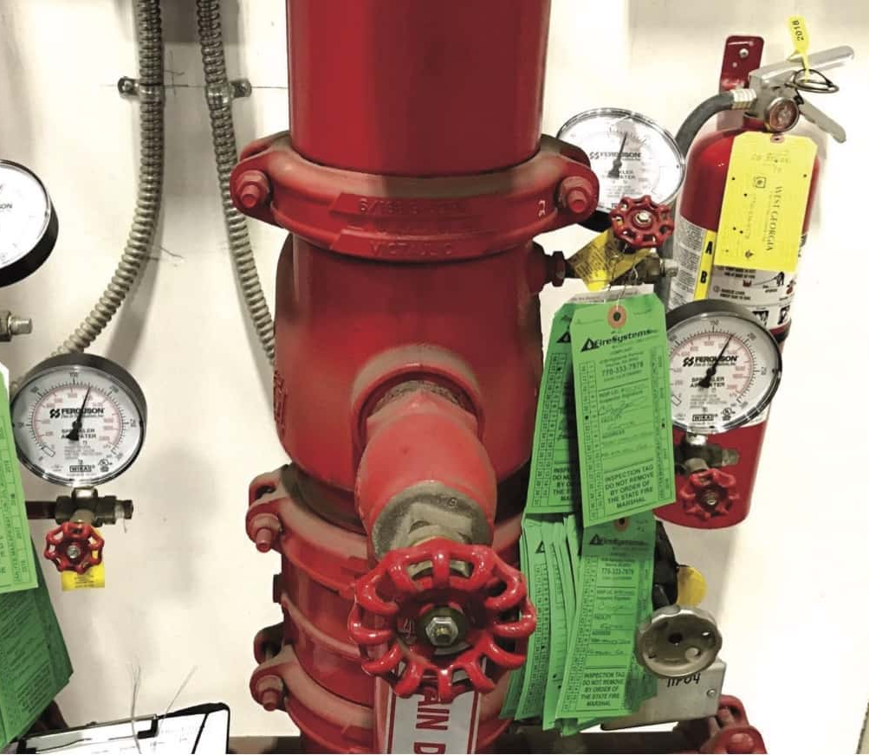
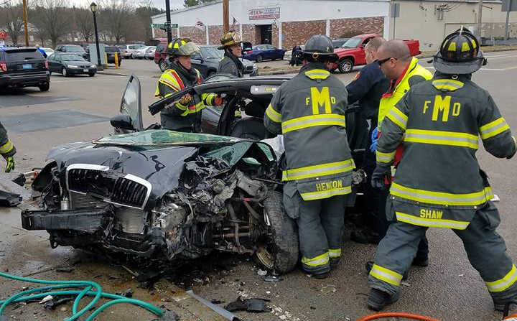
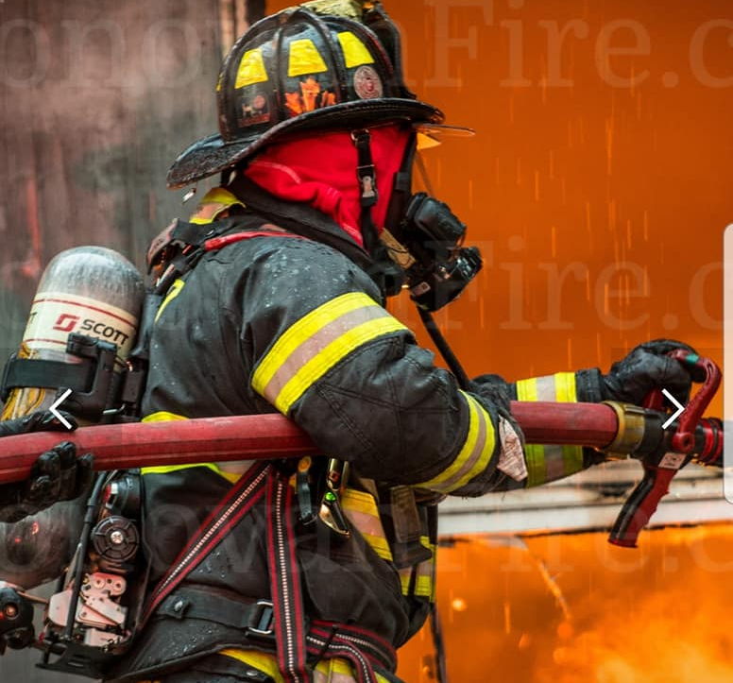

Programs and sub-programs
Structural Firefighting
Emergency Medical Services ALS & BLS
Fire Prevention & Code Compliance
Fire & Public Education CPR/First Aid

Slide 5
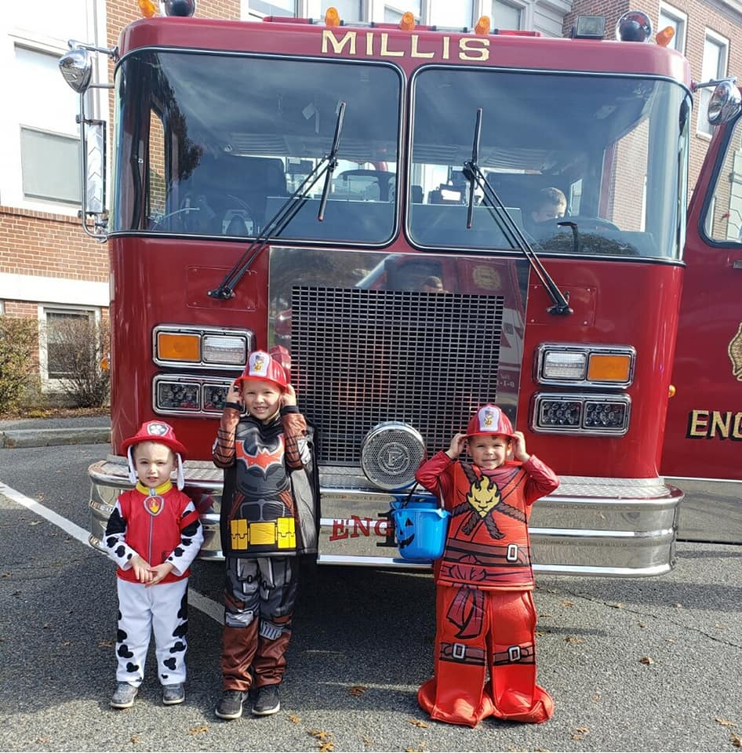
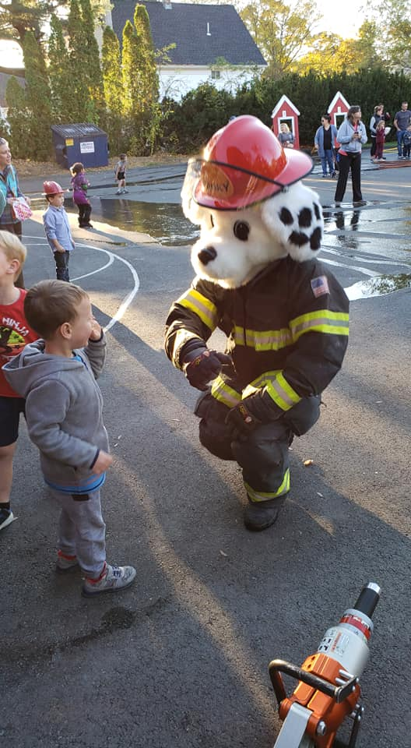
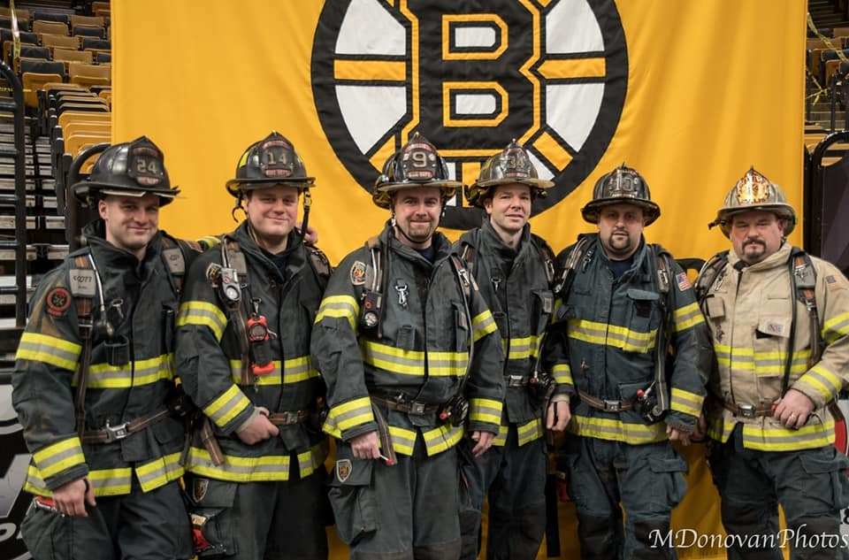
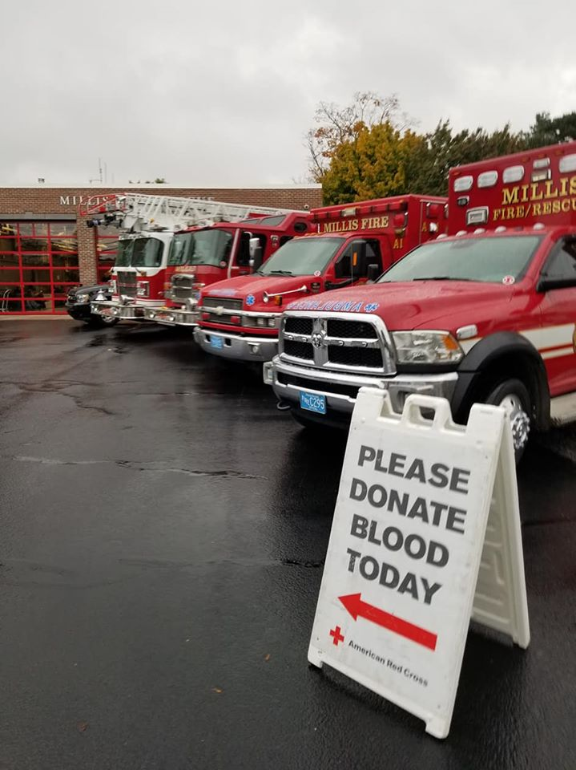
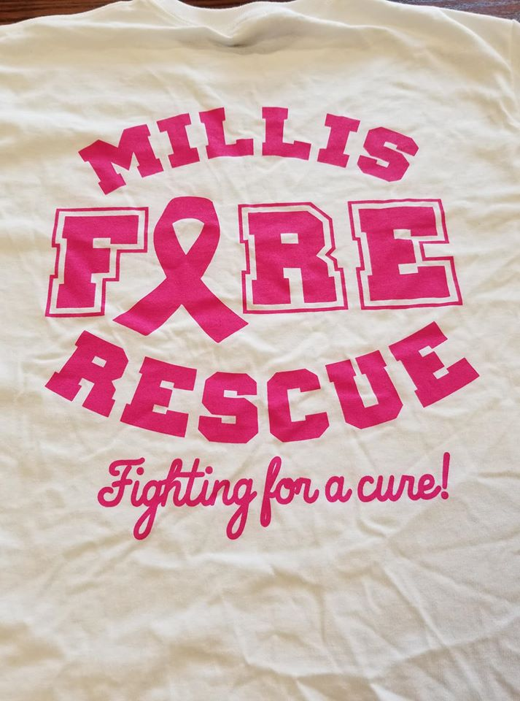
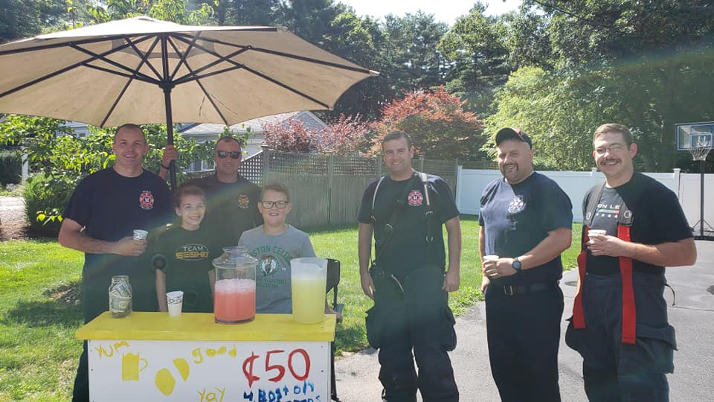
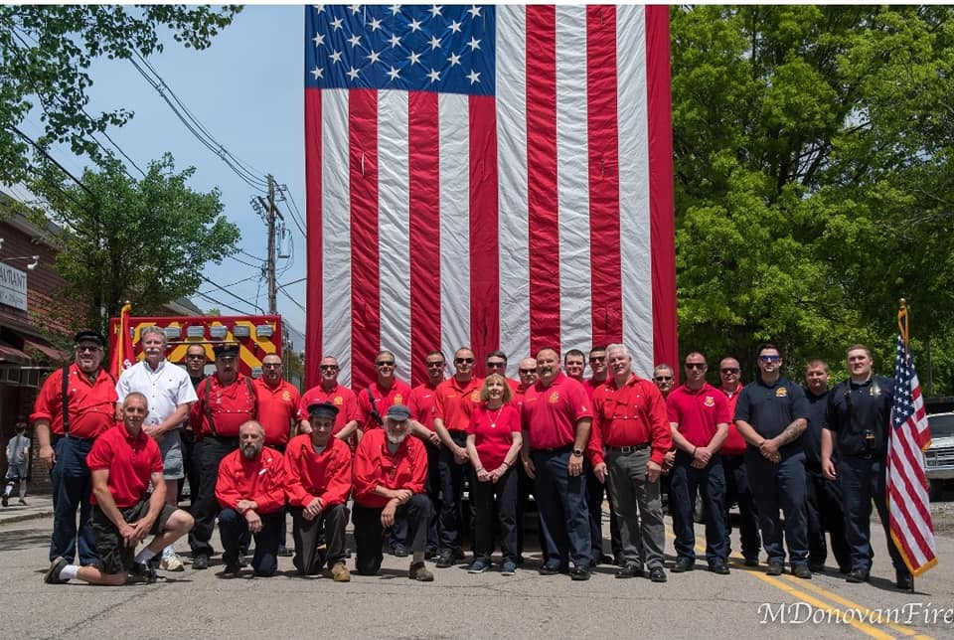
Fire Department Community involvement

Slide 6
accomplishments
First year of operating at the advanced life support level
Staffing of 2nd Ambulance
Call Volume increase of 15%
Per call collection rate increase of 42%
Monthly Collection Rate increase of 63%
Projected annual increase first year of $202,000 over 2019 collections

Slide 7
Accomplishments
Improved the Towns Iso Rating that directly effects homeowners
Received 3 separate Grants:
MIIA Grant-Funding for asset management and scheduling software-$5,500
EMPG Grant- Funding to replace the department multi gas meters- $7,000
SAFE Grant- Funding to provide fire prevention to grades pk-5th and fall prevention to our senior citizens $5,000
Junior Firefighter Program- Worked with the school to start a program to offer training to students interested in public safety.
Deputy Chief Position- with retirements within the department the ability to add this position became available.
On Call Members- all new call members became state and nationally certified
Turnout Gear& SCBA’s- with funds appropriated we were able to replace outdate equipment
Department Assistant- The addition of a part time department assistant has been beneficial as seen above with the ability to work on much needed grants.

Slide 8
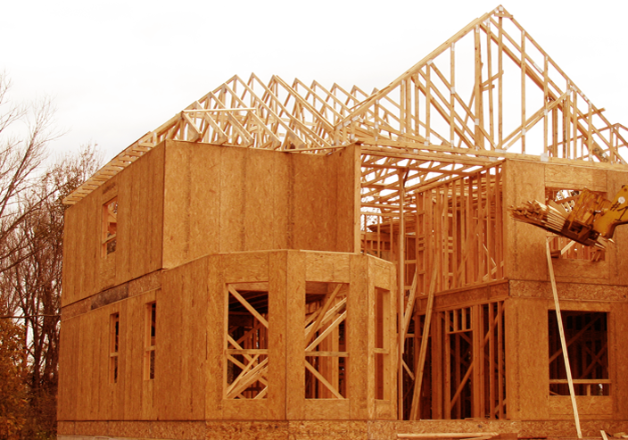
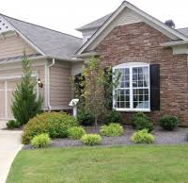
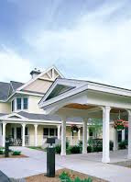
Fy21 Departmental Goals
Prepare for the large amount of new construction and the impact it will have on our response capabilities, plan review process, inspections and request for assistance.
A few of the projects underway and planned
324 units of over 55 community on orchard st
48+ units of over 55 community on acorn st
2 separate 40+ home developments
98 unit 4 story 40b project on union st
2 separate 12 unit 40b projects on main st
120+ bed memory care/assisted living facility

Slide 9
FY21 Departmental GOals
Our call volume is already increased due to some of these projects and upon completion these projects are projected to increase our call volume by at least 800 more EMS calls per year.
currently 42% of our call volume involves responding to patients over the age of 55, this is going to increase drastically with the addition of these communities.

Slide 10

FY21 Departmental Goals
SAFER Grant: The department will be applying for the SAFER Grant
(Staffing for Adequate Fire & Emergency Response).
This grant funds firefighters over a three year period and then the Town assumes the cost of the firefighters.
The grant works in a tiered system:
Year 1- The grant pays for 75% of the salary cost of all firefighters on the grant
Year 2- The grant pays for 75% of the salary cost of all firefighters on the grant
Year 3- The grant pays for 35% of the salary cost of all firefighters on the grant
Year 4- The town assumes all cost for all firefighters.

Slide 11

Fy21 departmental goals
If the department is successful in receiving the Federal SAFER grant, the town would have to fund the first-year salary cost of 1 firefighter, health benefits and overtime cost.
Step 1 Firefighter/Paramedic: $28.34 per hour
Annual Salary: $61,894.00
Family Healthplan: $12,875
Average OT Cost : $20,000
Total Year 1 Cost: $94,769.00
The Grant would cover the cost of 3 Firefighter Paramedics, health plans and overtime:
Annual Salary: $185,682.00
Family Healthplan: $38,625.00
Average OT Cost : $60,000
Total Year 1 Savings: $284,307.00

Slide 12
Fy21 departmental goals
Cost comparison for the hiring of 4 new firefighter/paramedics with and without the Grant
Without the Grant With Grant
1st year: $379,076.00 $94,769.00
2nd year: $409,402.08 $96,664.38
3rd year: $442,154.24 $287,400.26
4th year: The town assumes all cost for all 4 firefighters $477, 526.57
Savings over the 3 year period with Grant Funds: $751,798.68

Slide 13
Justification for request
This Grant helps us achieve a level of service that is required by our community. This grant will also expedite the process much faster than we could with traditional funding. This allows for many of the projects that are coming on line in town to be including in the budget planning process. The revenue that is being generated by the Advanced life support system will help to offset the cost of these new personnel. With our first full year of revenue generated by ALS we have seen a significant increase with projections of over $200,000 more revenue this year over last year. This is without many of the projects that will greatly impact our emergency response and increase the amount of EMS and Fire Calls that we will respond to and collect revenue from.
National Standard:
NFPA 1710 a national standard that all fire departments follow requires that a minimum of 4 firefighters respond on the apparatus within 2 minutes. Currently we have 3 on shift and have to wait for the 4th to arrive from off duty to staff the truck to meet this standard causing us to miss the 2 minute window.
Multiple Calls:
Additionally, with the increase in call volume we have been staffing the second ambulance more frequently. With a requirement of 2 personnel to respond, we have had to call back personnel to staff the ambulance increasing our overtime expense.
Overtime Impact:
With 3 personnel on duty, the need to staff at 3 at all times pushes up our shift coverage cost.
With the 4th firefighter on duty we can drop from 4 to 3 when necessary for budgetary reasons.
Area Communities:
Many Massachusetts towns have used this Grant to get their staffing to the level that meets the national standard. Medway, Norfolk, Franklin, Needham, Bellingham are just a few that have been successful with this grant.

Slide 14
Spending highlights for fy21
salaries
Chief- Level funded, contract expires June 30th, negotiations beginning soon
Full Time Personnel-
Contract in place until June, 30, 2021 2 ½ % increase included in budget for salaries & Stipends
On Call Personnel-
Level funded under personnel plan
We have 4 vacant positions
Department Assistant- Top step
Shift coverage: continues to be over budget due to on the job injuries
Overtime: with the increase in call volume our need to call members back has increased and will continue to.
Expenses
EMT Certification: New EMS software annual fee $1,500
Training: Increased Requirements/mandates for training outside of department $2,250
Supplies/Expenses: Medical equipment and supply cost continue to rise, call volume increase equals increased replacement of supplies $6,000
Telephone: Technology added to upgrade our reporting capabilities, asset management and data collection $3,000
Clothing/uniforms: increase for uniforms for call members and potential new fulltime members $3,000
Equipment: Preventative maintenance contracts for most of our equipment including radio repeaters $5,000
Equipment Repairs: Normal increase of $1,000
Maintenance Fire Alarm: Costly system set to be discontinued as of December 2020 requiring all master boxes to be converted to radio. Once removed maintenance cost will be reduced increase covers cost to remove wire throughout town.
Vehicle Supply/Repair- Preventative maintenance cost added to reduce chances of costly repairs as we found with Eng 2., $27,000 repair. increase of $5,000

Slide 15
Non Tax Funding fy21
Ambulance revenue receipts: Increase of 62% over last year with a projected increase of $200,000. Bringing Ambulance revenue to approx. $500,000
Construction plan review/inspections/permits: With the increase in construction in town the revenue generated from these items have increased to approx. $10,000.
Inspections and permits:
New construction inspections smoke & Carbon Monoxide detector inspections
Sprinkler installation inspections sprinkler testing
oil burner installations oil tank removals
fuel storage permits propane storage permits
blasting permits burning permits

Slide 16
Equipment Detail/capital replacement
Equipment replacement fy21:
Scott Air Pack Bottles: Year 2 of our replacement plan calls for the replacement of 12 bottles that expire in October of 2020 $12,000
Firefighters Turnout Gear: Year 2 of our replacement plan calls for the replacement of 13 sets of turnout gear to meet osha standards $36,725
Large Diameter hose: As with other equipment fire hose has an expiration date of 15 years, this hose being replaced is from 2005. $15,000
Because of grant funding we are able to take off the $35,000 scheduled for next fiscal year to replace our gas meters.
Next fiscal year our A1 (ambulance) is scheduled to be replaced as well as our Car 2.
A1-$325,000 car2-$60,000

Slide 17
Thank you & questions?

