Slide 1
Millis Public Schools
Small School, Big Family
FY21 Proposed Budget
A Culture of
Continuous Improvement

Slide 2
Budget Development Process
December & January: Superintendent and Administrative Team project fixed costs
and solicit input on critical needs
February: School Committee and administration develop draft budget in light of Governor’s budget and projected town revenue
April: Preliminary FY21 budget Public Hearing
April- May: Budget and warrants presented to Finance Committee.
Continue to monitor state and local funding sources.
Make adjustments for balanced budget at Town Meeting.
June?: School Committee approves final FY 21 budget amount.
Approval at Town Meeting.

Slide 3

Budget Development Premises
Meet needs of students & align to priorities
Maintain and improve education in Millis- identify strengths, opportunities for improvement and potential efficiencies
Prioritize excellent staffing
Pro-active planning –retain & attract students

Slide 4

Personalized Learning
Culture of strong relationships with students, active engagement, effort
Exemplary programs and academic excellence
Development of 21st c. skills with emphasis on authentic learning
Responsive, differentiated teaching
Notes:
Our approach is unique-
Our HS has earned the Premier Delegation Award for at least 3 years in a row for Youth In Govt. program!

Slide 5
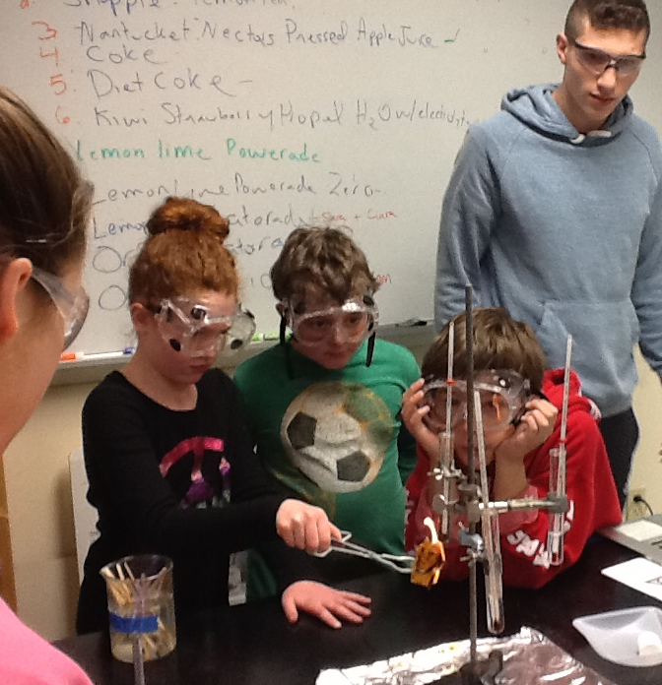
Budget FY21 Priorities:
Focus on Core Mission of Personalization
Maximize learning & well being of students- SEL
More student engagement and agency
Robust & relevant 21st century learning w/ Real World & STEAM opportunities
Maintain high quality instruction, programming and facilities
Notes:
Engineering Course! New Computer Science Courses!

Slide 6
Challenges- in addition to COVID-19
LACK OF REVENUE:
Chapter 70 funding
Lower enrollment
Social-emotional, mental health issues
Inadequate Athletic and recreational fields in Millis

Slide 7
Enrollment 2008 - 2020
Notes:
This year shows about 245 fewer students than the high of 2010 year,

Slide 8
Class Sizes 2019-20

Slide 9
FY 06 - 20 School Choice In-coming
Notes:
8 students will graduate this year and 12 the next year

Slide 10
FY 10 - 20 School Choice Outgoing

Slide 11
Charter School Enrollment

Slide 12
Notes:
Of the 61, 10 are homes chooled and 51 are private

Slide 13
Notes:
Average of 32

Slide 14
FY 19 Per Pupil Expenditure- Surrounding Towns

Slide 15
FY 19 Per Pupil Expenditure- Comparable Districts,
In-district students only

Slide 16
FY 19 Per Pupil Expenditure- Comparable Districts,
Including Out-of District students for Special Education
Notes:
Millbury moves up but all else stays the same

Slide 17
Percent Low Income Comparisons FY ‘20
Notes:
Local and comparable DART Districts

Slide 18
Reductions FY 12 – FY 20
16% DECLINE in expenses
from FY12 to FY20
$636,000 in reductions in FY16:
4.2 FTEs, expenses, hiring savings
$295,583 reduced in FY 17 level service budget: 3.4 FTEs affecting 8 staff, expenses
$424,857 reduced in expenses from FY 19 & loss of $60,000 in federal grant funding

Slide 19
Total Budget FY 21
Notes:
84% Salaries

Slide 20
Salaries FY 21
Notes:
Almost 66% teachers,

Slide 21
Fixed Costs- Salaries
FY 20 Budget
 |  |  |  | Salaries | $13,202,812
 |  |  |  | Expenditures | $2,653,852
 |  |  |  | Total | $15,856,664
FY '21 Prelim. Budget |  |  |  |  | 4/6/20
 |  |  |  |  | D R A F T
Salaries- Fixed Costs
 |  |  |  | COLA (est.) | $245,148
 |  |  |  | Steps (est.) | $148,536
 |  |  |  | Lanes (est.) | $61,699 | Based on 50% funding lane change requests + 2 new enhanced longevity
 |  |  |  | Supplemental Salaries | $7,941
 |  |  |  | Reduction of Salaries Funded By Choice | $100,948 | Reduce reliance on Choice for salaries
 |  |  |  | Ed Reform Increase | $65,831 | Actual Budget to Budget Increase
 |  |  |  | Transition Program ( 18-22 Year Old) | $120,000 | Will reduce Out of District Tuitions by $152,000
 |  |  |  | Increase SLP .10 FTE due to Caseload | $9,647 | Increased caseload at the CFB School
 |  |  |  | Retiree | -$40,000
 |  |  |  | Total Salary Increase | $719,750 | 4.54%
Notes:
Overall 4.1% increase

Slide 22
Fixed Costs- Expenses
Special Education OOD Tuitions | $30,000 | (If Transition Program funded)
Pre-Paid Tuitions | -$133,300
Inflationary Expenditures Increase | $0 | (2% would have been $53,000)
Required New Expenditures | $17,817 | Smartsuite for CFB (1,653), FY 21 Share of MUNIS $8,000, Wifi/Xirrus License Renewal $8,163
Total Expenditure Increase | -$85,483 | -0.54%
Notes:
Overall 6 and a third% increase due to high Sped. Costs and 30% increase overall in utilities.

Slide 23
Total Increase = 4%
 |  |  | Total Increase | $634,267 | 4.00%
FY '21 Level Staff Budget (after $160K in reductions- thus, not Level Service) |  |  |  | $16,490,931
Notes:
Overall 6 and a third% increase due to high Sped. Costs and 30% increase overall in utilities.

Slide 24
High Performing Districts
Research on “Learning Organizations” (Drucker, Senge, etc.), change management and educational best practices
Guaranteed and viable curriculum- Power Standards
Clear instructional vision w/ PD to support growth
Deep Implementation of few (3-4)
Highly qualified staff focused on improvement
Opportunities for collaborative learning and planning
Support & challenge for ALL students (SEL, ELL, SWD & Low Inc.)
Parental and community involvement

Slide 25
Essential School District FY21 CORE Needs:
High School and Gr. 8 | Bridge Counselor Increase .65 to 1.0 | $11,000 (offset w/ SEL Para savings) | Proposed for Marijuana Funding: Expand program to address needs of students with low attendance & school engagement due to health and/or mental health concerns. Cost prevention since these students often end up in out of district placements.
District | Expand services for EL students | $18,000 | Expand small group and individual tiered services for growing population (currently 29 students)
Notes:
Over $400,000 in needs that are critical to maintain quality of instruction and programming

Slide 26
School District FY21 Critical Needs:
High School | DECA class & program | $13,815 | Providing real-world options with a business/ marketing/entrepreneurial focus will retain students and provide them with valuable skills
CFB | School Adjustment Counselor .6 to .8 | $12,984 | Increase in students at CFB requires increased time. Social-emotional learning is a foundational skill for learning. Proposed for funding by marijuana revenue.
CFB | PD and Summer Curric. Dev. | $20,000 | Professional development and curriculum development in reading are the essential focus for 2020-21 at the Clyde Brown School.
District | Add curric. line: budget | $10,000 | Introductory amount for essential curriculum adoption and development line item rather than submit as warrant articles
District | Increase of funds to restore past cuts | $15,000 | Professional development funds for teachers and other staff are exhausted in the Fall. This reduction occurred many years ago and we have not been able to restore it yet. PD is essential for improvement.
Notes:
Over $400,000 in needs that are critical to maintain quality of instruction and programming

Slide 27
District | Clerical Support | $15,000 | Expand hours of part-time Administrative Assistant
CFB | Tiers Support for Reading & Math | $40,000 | The addition of Gr. 5 to new CFB added 100+ students. This expands support services available to students
CFB & Middle | .4 Reading Specialist | $25,968 | Literacy Study will provide recommendations for poor performance MCAS ELA Gr.3 & 5
Middle School | Options in Engineering | $12,984 | Expand Unified Arts in Middle School and replace STEAM program currently taught by Gr. 8 Science
CFB & Middle | Summer Tiers Support | $10,000 | Increase of summer tutoring- small group and individual, for students who need additional support
High School | Maker Space | $20,000 | Outdoor Learning STEAM & Maker Space in courtyard- could be offset w/ local business donations
 | SUB- TOTAL | $224,751 | If Core & Critical Needs funded = 5.4% over FY 20

Slide 28
CAPITAL NEEDS & WARRANT ARTICLES
Existing Bus Lease | $89,999
Medicaid Administration | $5,000
Computer Leases | $69,900
Curriculum & Instruction Materials | $10,000
Year three Locker Replacement- HS | $30,000
Year Two Furniture Replacement | $22,000
Skid Steer & attachments | $45,000
 | $271,899

Slide 29

To ensure that students who come at the curriculum from many directions all find meaning and inspiration from what they learn, I will teach to both the commonalities students share as human beings and the variability they bring with them as individuals.
-Carol Ann Tomlinson
The school is the last expenditure upon which America should be willing to economize.
~Franklin D. Roosevelt

