Slide 1
Notes:
slide 1 MPRI screen saver

Slide 2
This Bylaw will
eliminate single-use plastic bags at checkout.
Eliminate 2,870,000 plastic bags in Millis EVERY YEAR
Have no negative budget impact
Notes:
this will be seen in slide about recycling.

Slide 3
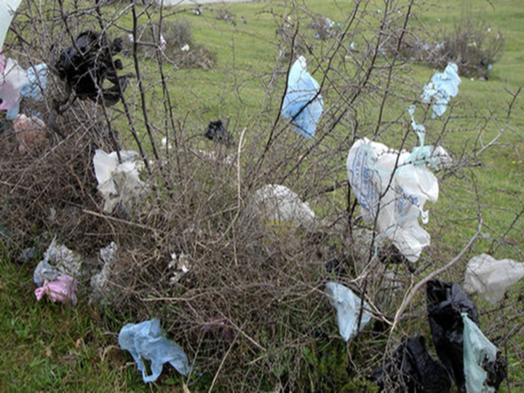
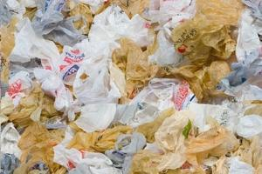
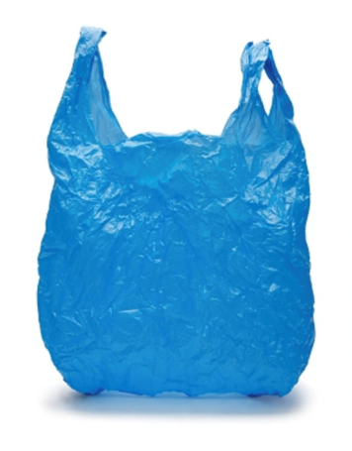
This Bylaw will keep Millis cleaner.
Notes:
NY state banned single use plastic bags, the third state in the country besides CA and Hawaii.
It was such a problem here was talk of making the airborne bag the state flower.
This could be certain places in most towns. This effort is trying to change that in Millis.

Slide 4
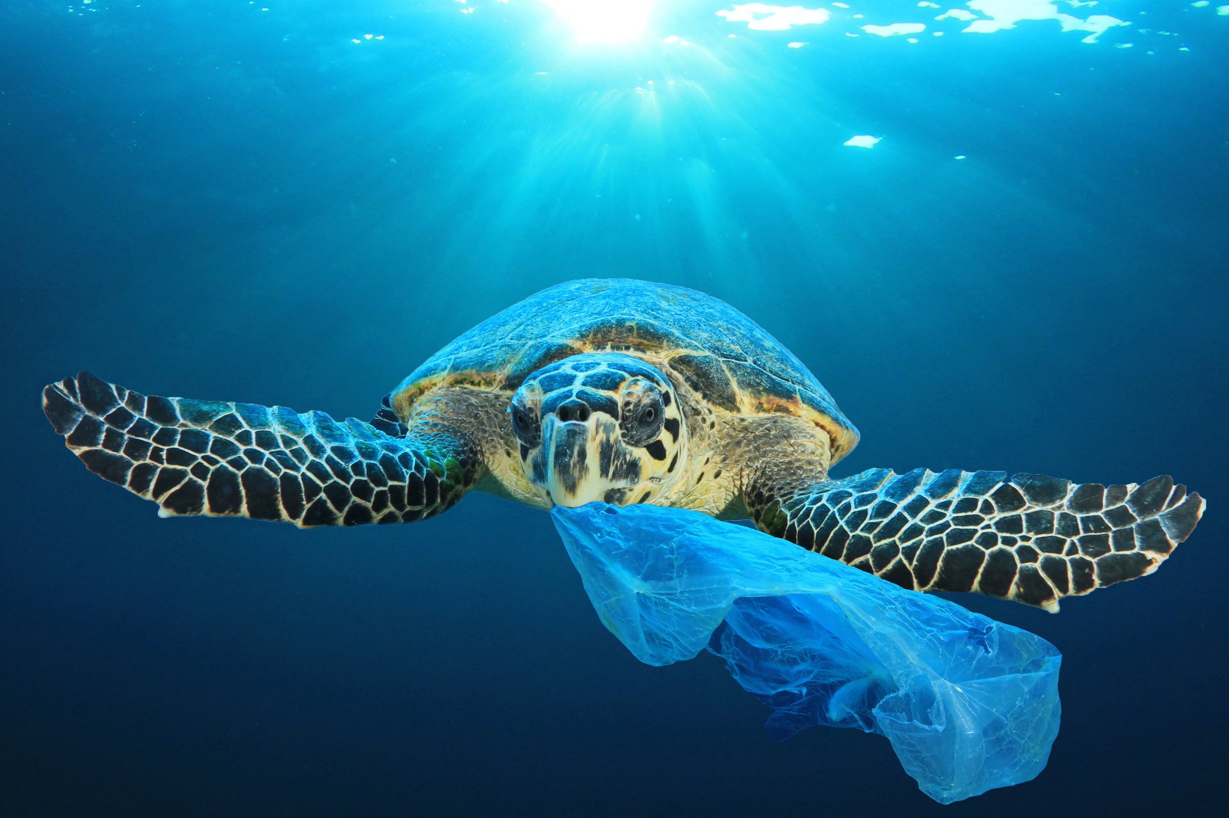
122 towns in Massachusetts have already passed plastic bag ban legislation.
Notes:
this is a town count for bag bans only although many towns have moved to ban other plastics.
Our Bylaw is to bag plastic bags at checkout

Slide 5
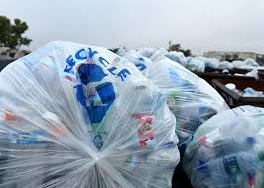
Why ban plastic bags?
Plastic bags:
Affect our health.
Pollute our environment and contribute to marine life devastation.
Costs the town money.
Notes:
Air quality is affected by emissions in manufacturing and emissions by trucks delivering plastic bags to retailers.
Petrochemicals and fossil fuels that break down into tiny pieces but never disappear. They’re incinerated or dumped and clog the sewers that dump into water systems. Charles Rv to Boston Harbor. This isn’t about recycling here it’s about not using single use plastic bags.

Slide 6
Disposal Costs
Municipalities charge us for waste removal, and this cost will rise with our increased consumption of plastic and the world’s inability to dispose of it.
The big problem with plastic bags is that we are not disposing of them properly.
Recycle Smart Video
By eliminating plastic bags we are saving Millis money.
Notes:
We save money because we recycle. We’ll save more money if we do it smarter.
Over 5 yr Recycling CORRECTLY 1,433 tons of co-mingled and paper /fiber waste, Millis and saved $40,374.00.
Rating system: By taking plastic bags out of the co-mingled stream, our rating will increase and the cost of this recycling will decrease. Millis pays: blue bags $67.59 per ton, co-mingled $35 ton, paper $25 ton.

Slide 7
show numbers??

Slide 8
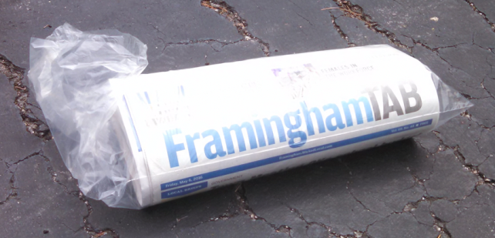
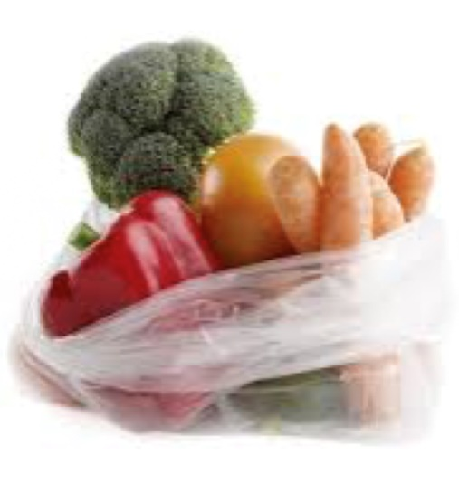
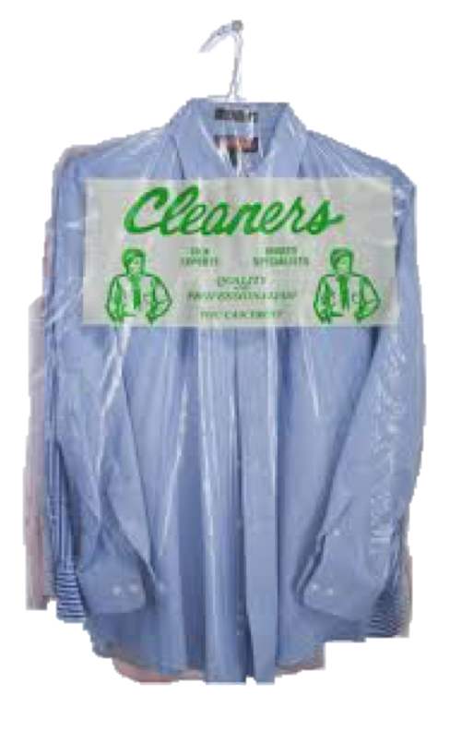
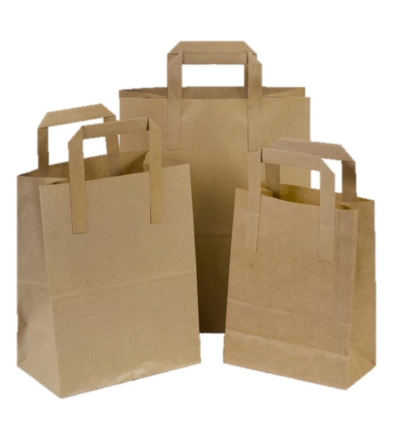
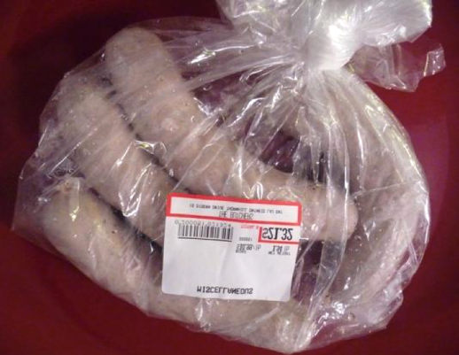
Not Affected by the Ban
Newspaper bags (can be reused for so many things)
Dry cleaning bags
Vegetable bags without handles
Bags used for packing meat or fish
Paper bags
Notes:
won’t be affected by the bag ban but you can still substitute for certain bags (veggie) Mesh bags or make your own cloth bags. Remember to wash all bags regularly per instructions on bags.
A dry cleaner in town has reusable bags for a small charge. There are ways around plastic bags and we just have to pay attention. That’s how I’m talking to you now.

Slide 9
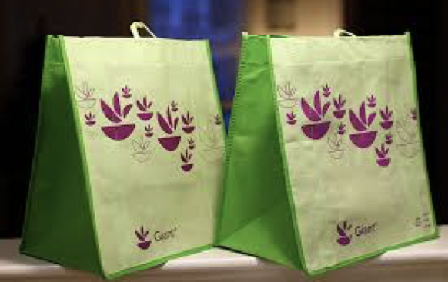
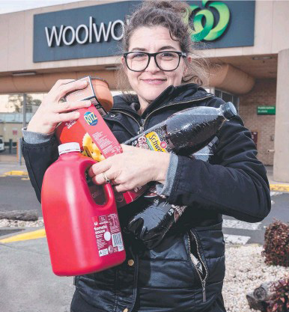
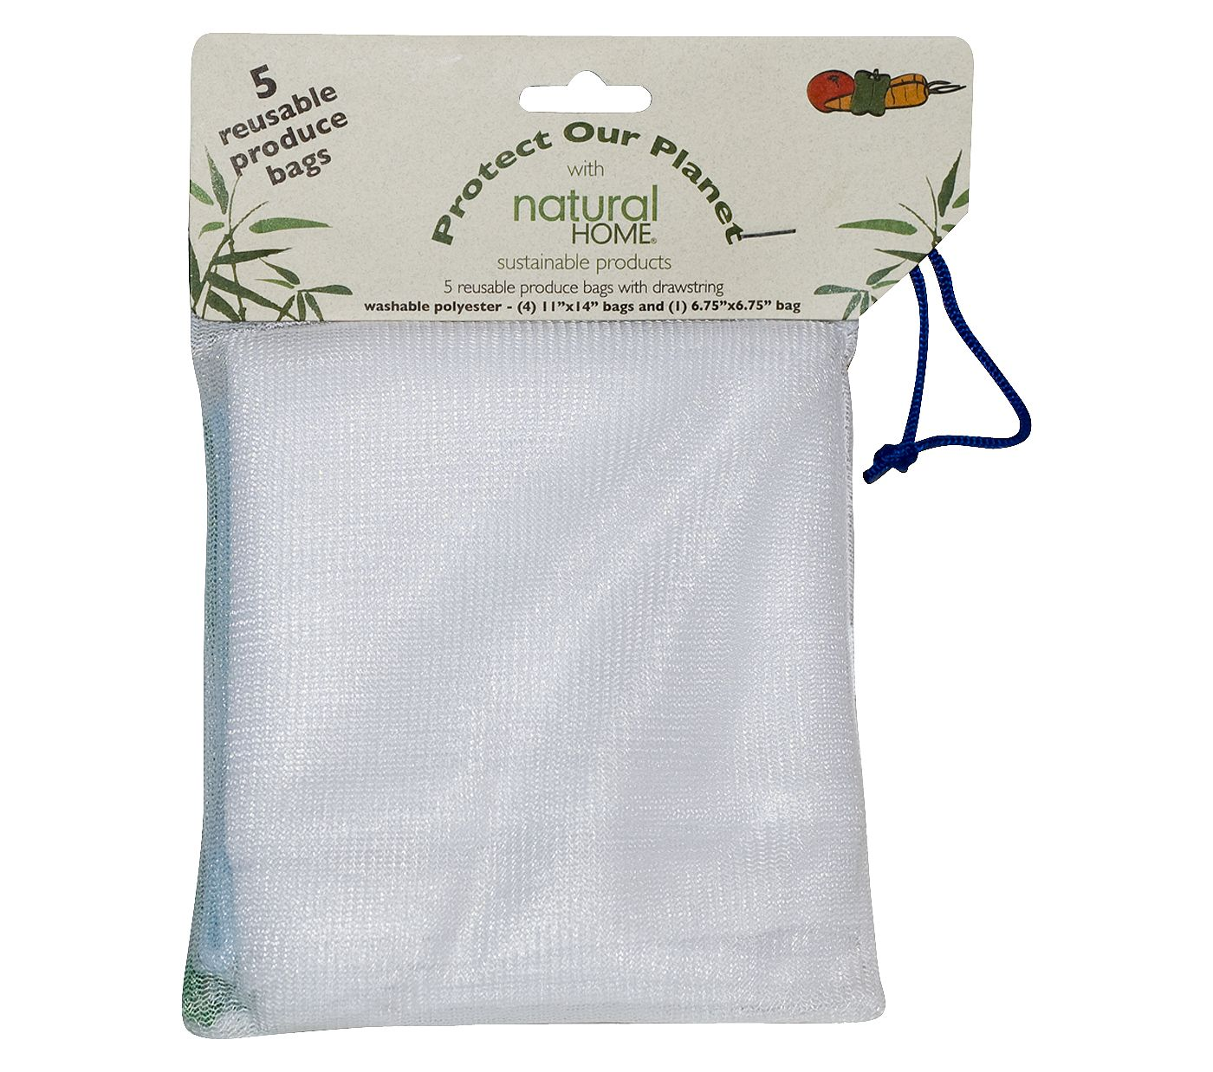
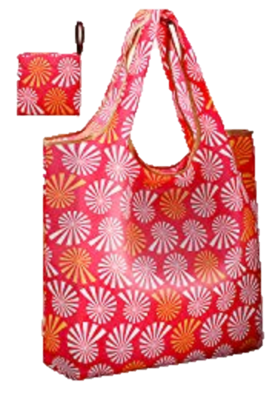
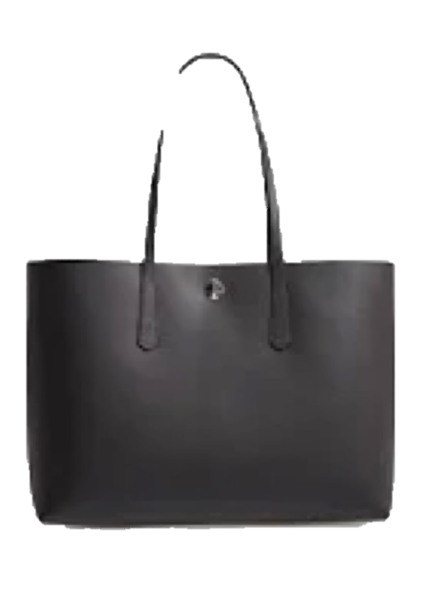
Reusable Bag Options
are made from cloth, canvas or mesh nylon
are double handled & washable
are inexpensive or free
paper bags are exempt but not the best choice
REMEMBER TO BRING YOUR REUSABLE BAG INTO THE STORE!
Notes:
when you go to your bank or often at public events vendors offer free reusable bags as advertising. Keep your eyes open. Also sold for under a dollar at most larger stores. Grocery bags are different shape than bags from mass merchandisers. We can always refuse a bag if we forget our reusable one.

Slide 10
Community Outreach began in February
February floated initiative to Millis Garden Club Leadership Group
Library leant support and cooperation from the start
Notices to listerv from MPS and Select Board
Bag It movie with follow-up discussion
Display of Alternatives to Plastics at Library- ongoing
April Presented to Lions Club at monthly dinner
Presence at town-wide events: Tangerini Farm concert & Millis Night Out
Visited retailers (ongoing effort) and invited all to a July 11 gathering to talk about concerns
Wall-E movie family event Sept. 20 at Library at 6 with craft for kids at 5:30
October Plans to chat with seniors at the COA
Next month Plans to present to all PTOs
Encourage attendance at Town Meeting on November 4!
MPRI contact info is on all materials and follows on the next slide
Notes:
-The discussion began and decided to keep separate from town groups but involve supporters
-Education and learning about the problems created by plastics really gets people talking.
Alternatives: silicon and bees wax coverers for containers, aluminum straws, glass containers instead of plastic: alternatives are reusable for a long time.
-people are animated when the topic of a plastic bag ban in brought up.
-

Slide 11
Vote YES on November 4th
For more information contact
Geri Sprague millispri@gmail.com
or check out facebook.com Millis Plastic Reduction Initiative-MPRI
Notes:
In preparing this slide show I learned a lot about technology and got even deeper into the problem with plastics especially single use plastic bags. It’s not a nice picture but we can start to make a difference by approving this Bylaw.
Please go to town meeting on November 4 and vote YES? Thank you.

